Slide 1
Unit 8 :
Programming data bases
Session 1
DataBases

Slide 2
Introduction
All DBMS allows users to unlock:
Routines.
Formed by a series of instructions that allow you to carry out a task
After the routine, it can be called or called to eject at any time.
The rules that can be discovered in MySQL and, in general, in any related DBMS:
Functions.
Procedures.
Triggers.

Slide 3
Introduction
Ventajas de usar rutinas almacenadas:
Each automated process has several instructions. No need to rewrite these instructions.
Customers should only want much information from the service provider. The server has the stored routines.
If the routines are perfectly complied with, you may be sure that the processes are carried out correctly.
Desventajas de usar rutinas almacenadas
Portability. There are differences in SQL language to create routines in different DBMSs so that a data base with routines is created in a DBMS that cannot be portable to other DBMSs for these routines.
It may produce errors when running a routine that are difficult to detect.

Slide 4
Introduction
To remove routines, use a programming language. In MySQL, the programming language includes a series of instructions for:
Create the type of routine.
Declare variables.
Manage variables.
Establish the behavior of the parameters.
Make control of the flux of the program.
Management of cursors
Control events.
Devolve values.

Slide 5
2.- User and system variables
In MySQL we can use the types of variables:
System variables:
The server is created when initiated and/or when a session is initiated.
The value that you have is variable in configuring the behavior of the server and the sessions.
For example, the autocommit variable that you see when studying transactions is a system and session variable.
Only users with appropriate privileges may modify the values of these variables.
User variables:
You declare or create a user to use and modify them during the session.
When a session is created, all the user variables that are created in the missing session will be created.

Slide 6
2.- User and system variables
The server creates and maintains various system variables that indicate how they are configured. All of them have defective values. You can change the value by setting the server using options on the command line or configuration files . In the majority of these ( dynamics ) we can modify their value during the session using the SET command.
System variables can be global or session variables. Global variables are set to global server configurations. Session variables configure sessions or for individual client connections. Much of these are global as session (really has a global value and has a value for each session).
Initiating the server, you can modify the value of the global variables that are dynamically assigned to the command SET GLOBAL variable=value.
The value of the session variables that its dynamics can change through a command SET SESSION variable=value

Slide 7
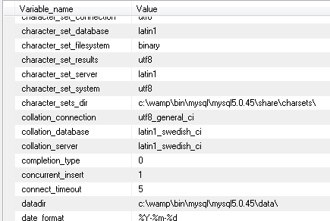
2.- User and system variables
You can view system variables and their values using the SHOW VARIABLES command.

Slide 8
2.- User and system variables
Examples of modifying variables via SET GLOBAL or SET SESSION . If written solo SET, it is equivalent to SET SESSION. LOCAL, @@SESSIO N. y @@LOCAL. its equivalent to SESSION.
EJEMPLOS:
SET SESSION autocommit =0;
SET autocommit =0;
SET GLOBAL max_connections =5;
SET GLOBAL character_set_results =utf8;
SET SESSION character_set_results =utf8;
SET @@SESSION.character_set_results=utf8;
SET character_set_results =utf8;
SET LOCAL character_set_results =utf8;
SET @@local.character_set_results=utf8;

Slide 9

2.- User and system variables
You can consult the system variables if the number coincides with a pattern. For example, if we want to see the values of the session variables as the number comes by auto_ , we will include:
SHOW SESSION VARIABLES LIKE 'auto\_%';
The result is the value of variable backs that indicates the initial value or is arranged for an auto-increment column and when the value of this column is increased every time a new register is inserted.

Slide 10
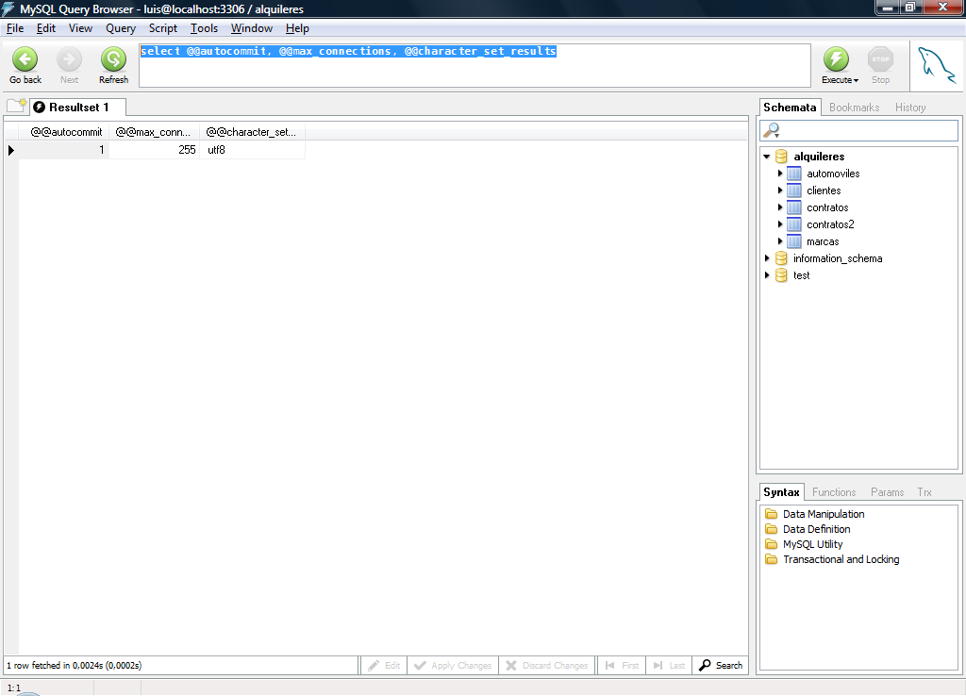
2.- User and system variables
You can also obtain the values of session variables using SELECT .
To consult your value, you must write the number of the variable preceding @@
Example:
SELECT @@autocommit, @@max_connections, @@character_set_results;

Slide 11
2.- User and system variables
SOME IMPORTANT SYSTEM VARIABLES:
autocommit : Set to 0 if the transaction status is enabled.
basedir : Route of the MySQL directory. It is not dynamic.
character_set_server : Set of characters used in the server.
snack_server : Colación por defecto del servidor.
datadir : Directory where databases are stored. It is not dynamic.
init_file : Number of server configuration files, default MY.INI. No dynamics.
log: Vale true if the consultation registry is activated. No dynamics
log_updates : Vale true if the updates log is enabled. No dynamics.

Slide 12
2.- User and system variables
ALGUNAS IMPORTANT VARIABLES:
max_connections : Maximum number of connections permitted simultaneously.
max_user_connections : Maximum number of sessions that can be initiated by a user.
port : Port number that MySQL uses to support TCP/IP connections. No dynamics.
skip_networking : True if the server only allows local connections. No dynamics.
table_type : Table type predetermined to create tables without specifying your type. No dynamics.

Slide 13
2.- User and system variables
STATE VARIABLES
The server maintains many state variables that come from information about its operations. You can see these variables and their values using the SHOW STATUS sentence.
The value of these variables changes the server depending on the status of the actions carried out by the users.
However, a user can directly modify the value of these variables.

Slide 14
2.- User and system variables
SOME STATE VARIABLES
questions: The number of consultations you have requested from the service provider.
uptime: The number of seconds that the server is working.
slow_queries: The number of queries that took longer than long_query_time seconds
max_used_connections: The maximum number of connections that you have used simultaneously when the server has started it.
innodb_rows_inserted: The number of records inserted in InnoDB tables.
connections: The number of connection intents (with or without availability) to the MySQL server.
aborted_connects: The MySQL server connection number failed.
com_select: Number of select instructions sent in the session.
com_insert: Number of instructions inserted in the session.

Slide 15
2.- User and system variables
USER VARIABLES
As you can see in topic 5 (session 7) A user can create user or property variables.
The user variables are declared with @number_var , where the number of variables number_var can consist of alphanumeric characters and the characters ' . ', ' _ ', y ' $ '.
A way to set up a user variable is to use a SET instruction :
SET @ number_var = expression ;
Another form of creating user variables and/or assigning values is to be assigned a value developed by a consultation. For example;
SELECT @maximo:=MAX(numcontrato) FROMcontratos ;
SELECT * FROM contracts WHERE numcontrato =@maximo;
--
SELECT max ( numcontrato ) INTO @nummayor FROMcontratos;
SELECT finished INTO @fecha FROMcontratos WHERE numcontrato =@nummayor;

